Slide 1
Data physicalization: a new tool for the 21st century
Spencer Arshinoff
PSYC6135: Psychology of Data Visualization
April 11th, 2024

Slide 2
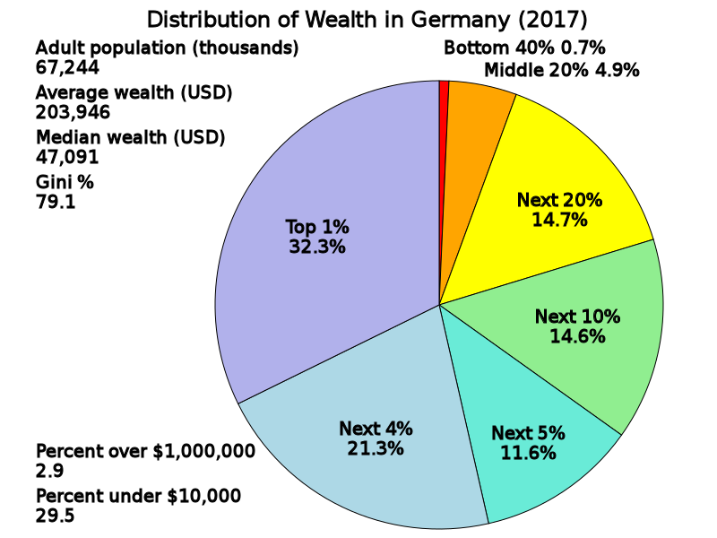
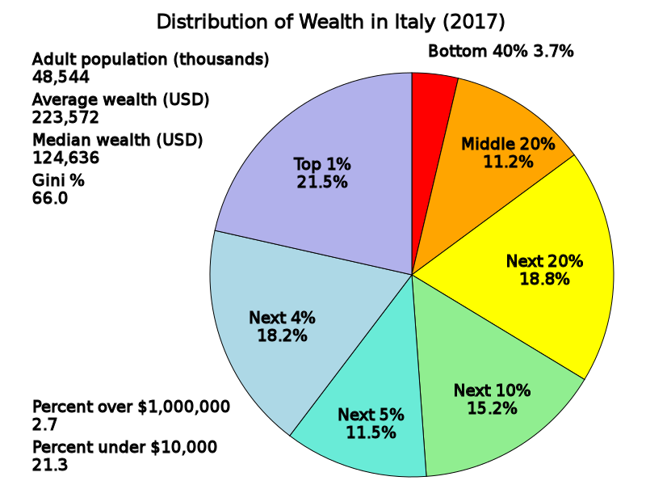
Image source: https://commons.wikimedia.org/wiki/File:Distribution_of_Wealth_in_Germany.svg
Image source: https://commons.wikimedia.org/wiki/File:Distribution_of_Wealth_in_Italy.svg
Notes:
This is one of my first experiences with data physicalization and is a good illustration of why it’s helpful
What percentage of wealth is possessed by the 1% of wealthiest people, 4%, etc
Clearly there is a difference here (Gini?), but it’s not immediately obvious

Slide 3
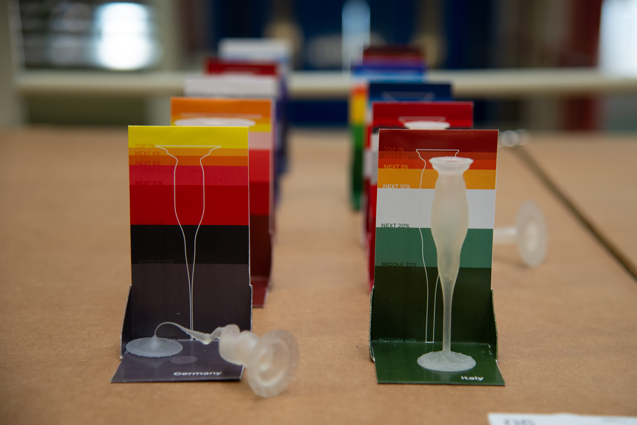
Xushan Li – Wealth Inequality (2020)
Image source: https://infopoetry.densitydesign.org/infopoetries/wealth-inequality/
Notes:
This is a better way (I think) of presenting the data
The width of each area represents the proportion of wealth held by that percentile
If the glasses literally cannot stand, that means your society is probably unstable

Slide 4
Presentation Outline
What is DP?
History of DP
DP vs. DV
DP vocabulary
Examples of DP
Recent advances in DP

Slide 5
What is DP?: Establishing a Formal Definition
Data physicalization (noun):
“[A] physical artifact whose geometry or material properties encode data” (Jansen et al., 2015, p.2)
NB: Not strictly the same as physical models – must contain abstract data
E.g., architectural models, molecular models

Slide 6
What is DP?: Establishing a Formal Definition
But, just like data visualization, there is another definition
Refers to area of research as well

Slide 7
What is DP?: Re-establishing a Formal Definition
Data physicalization (noun):
“[A] physical artifact whose geometry or material properties encode data” (Jansen et al., 2015, p.3228)
“[A] research area that examines how computer-supported, physical representations of data (i.e., physicalizations), can support cognition, communication, learning, problem solving, and decision making” (Jansen et al., 2015, p.3230)

Slide 8
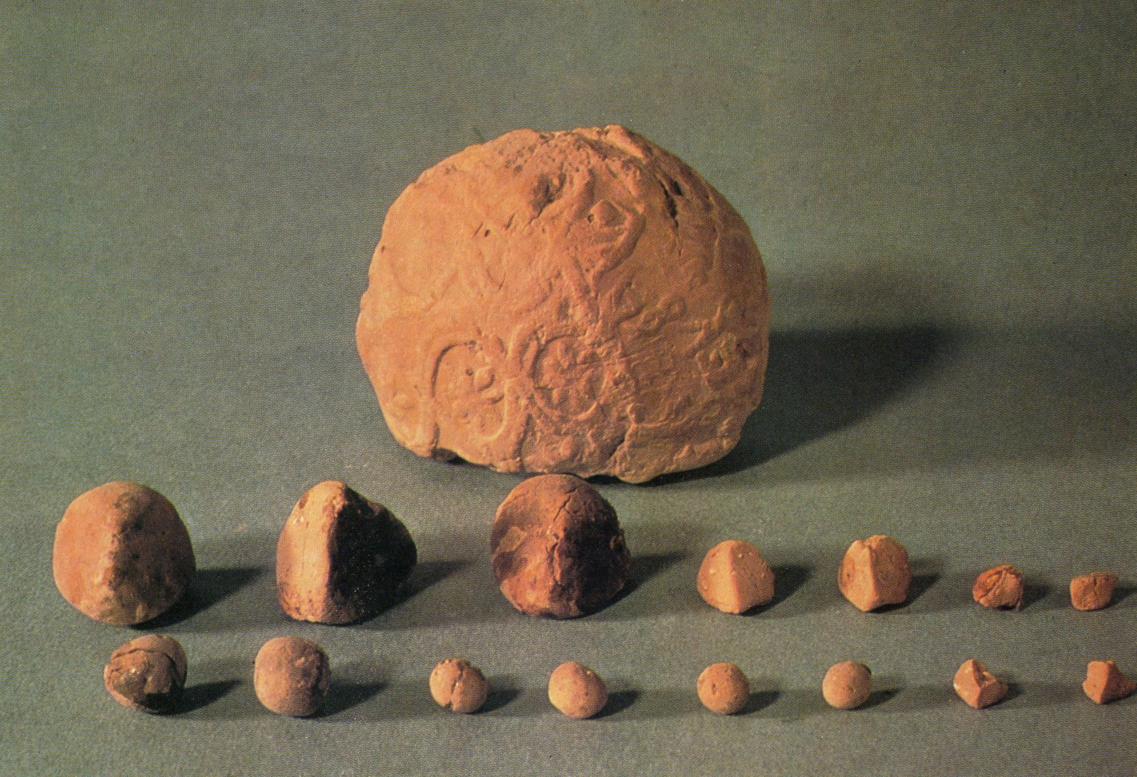
History of DP: Milestones
First data physicalization is ~7,500 years old (predates writing) from Mesopotamia
Clay “tokens” could be rearranged to represent financial data
Image source: http://dataphys.org/list/mesopotamian-clay-tokens/

Slide 9
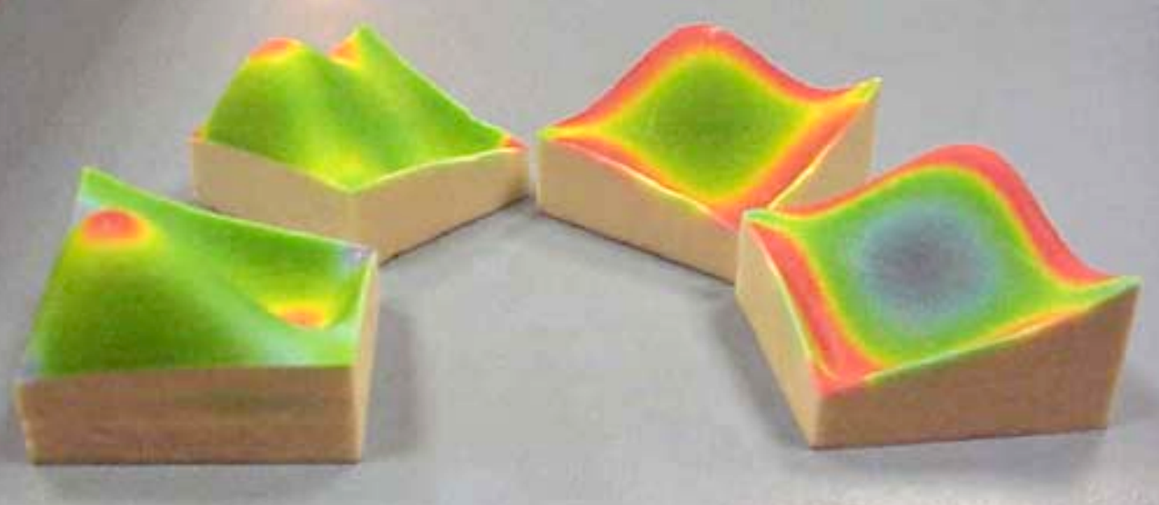
History of DP: Recent History
DV was revolutionized by computer graphics
Became accessible, easy to mass-produce and disseminate
New technologies (e.g., 3-D printer, laser cutters) are beginning the same process for physicalization
First 3-D printed data physicalizations were made in late 1990s
Image source: http://dataphys.org/list/sdsc-telemanufacturing-facility/

Slide 10
History of DP: Research (or lack thereof)
DP research is very nascent
Google Scholar search for “data physicali?ation” (in quotes):
1,120 results (as of March 31st)
Only 11 from before 2015
765 (over two thirds) since 2020
Already 52 this year
Notes:
I had to use the question mark because there’s also the British spelling with an s
This is just a back of the envelope type survey to give a general idea of the state of research
There are a few other terms that are sometimes used as substitutes like data materialization
Also, I don’t know how many articles were written by AI

Slide 11
Data Physicalization vs. Data Visualization
Data physicalization:
More accessible
More perceptual dimensions
Large-scale participation
Fun for children
Novelty
Data visualization:
Low learning curve
Less specialized equipment
Disseminated easily
More sustainable
Familiarity

Slide 12
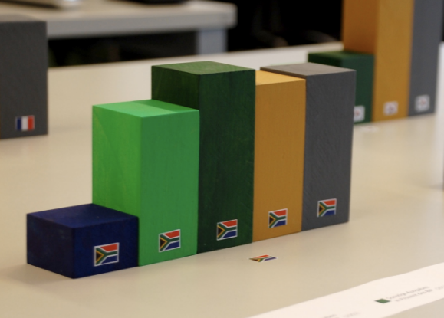
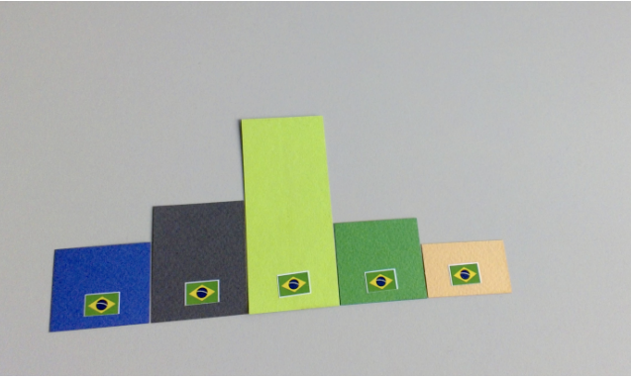
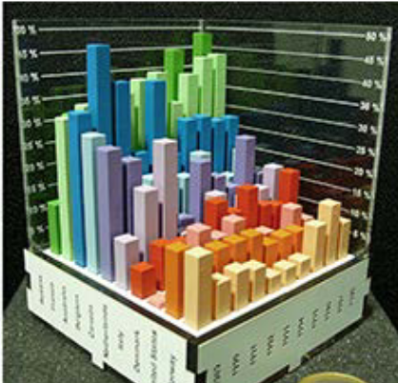
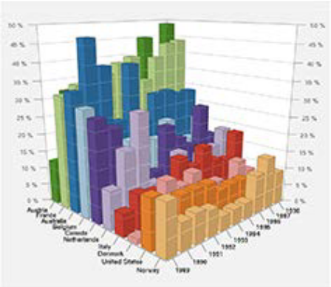
Data Physicalization vs. Data Visualization
Three-dimensional DPs can be better than DVs in terms of recall and understanding
Two-dimensional DPs are still better than DVs
In three dimensions, tangible DPs are preferable
3-D physicalization
2-D visualization
Image source: https://doi.org/10.1007/978-3-319-27648-9_94-1
Tangible 3-D visualization
On-screen 3-D visualization
Image source: https://doi.org/10.1007/978-3-319-27648-9_94-1
Notes:
Clearly, just seeing an object in 3-D doesn’t give you the full effect – you have to interact with it

Slide 13
DP Vocabulary
It is useful to create a shared DP vocabulary, just as with DV
We can describe DPs in terms of formats, dimensions, variables, and levels of abstraction

Slide 14
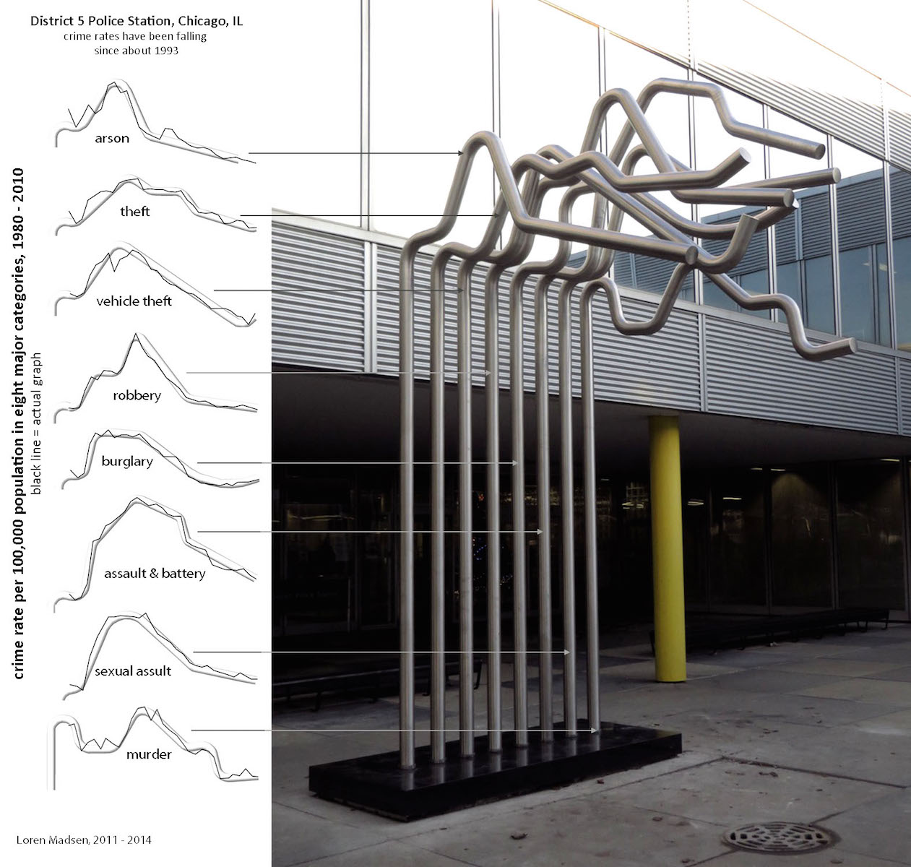
DP Vocabulary: Formats
Data sculpture: Artistically/aesthetically oriented
Ex: Nameless work in Chicago by Lorne Madsen (2015) showing decline in violent crimes since 1993
Image source: http://dataphys.org/list/district-5-tube-charts-reveal-decline-in-violence/
Notes:
I guess you could use it as a bike rack…

Slide 15
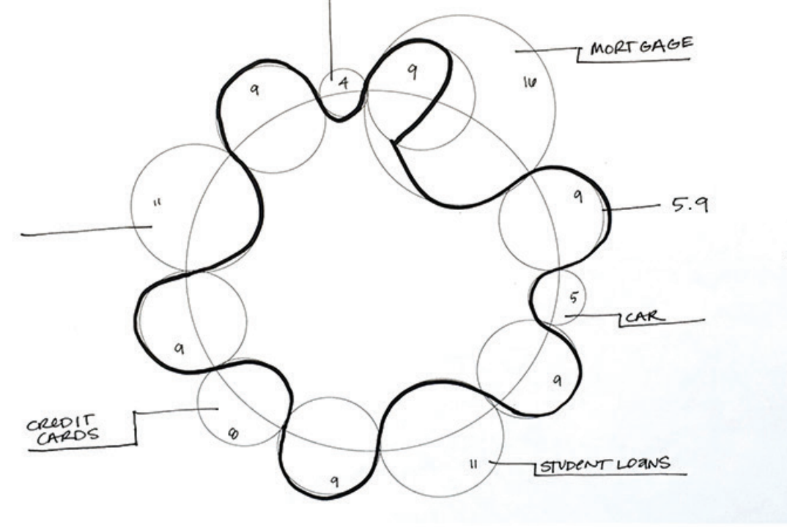
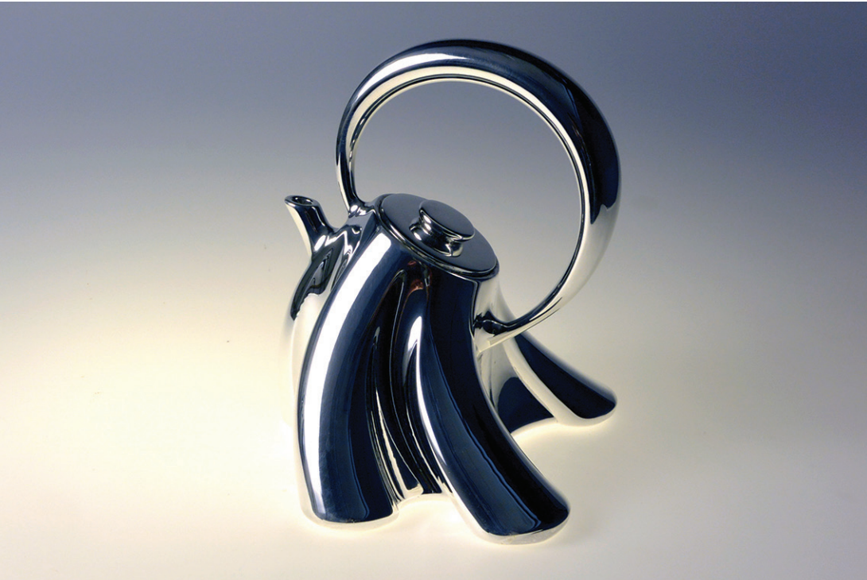
DP Vocabulary: Formats
Data objects: Functionally/instrumentally oriented
Modern Dowry by Courtney Starrett (2017) is a teapot whose shape represents monthly budget
Image source: https://doi.org/10.1145/3202918.3203087

Slide 16
DP Vocabulary: Formats
DPs exist on a spectrum of “purpose”: form vs. function
Data sculptures and data objects represent extreme ends of the spectrum
Most probably lie somewhere in between

Slide 17
DP Vocabulary: Dimensions
A good DP format has the potential for all three:
Granularity: Number of elements
Manipulability: Elements can be manually re-arranged
Actuation: Elements can re-arrange themselves

Slide 18
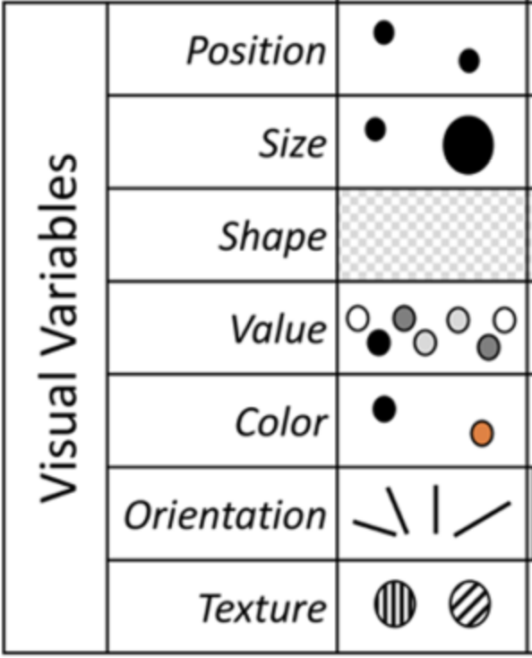
DP Vocabulary: Variables
DVs work using variables such as colour, shape, orientation
Many DPs can be perceived visually with the same variables
However, we need new ones to describe the sense of touch

Slide 19
DP Vocabulary: Tactile Variables
Hornecker et al. (2023) list the following nine tactile variables
Size
Contour
Roughness
Texture orientation (AKA lay)
Friction
Deformability under force (AKA compliance)
Temperature
Vibration
Force

Slide 20
DP Vocabulary: Other Variables
Other senses can be stimulated by DPs and can be broken down into variables as well
Sound: location, pitch, timbre, volume, duration
Kinesthesis (our sense of body position and movement): motion, speed, weight, inertia, viscosity
Taste and smell: sweet, salty, savoury, sour, bitter, “mouthfeel” (Hornecker et al., 2023)

Slide 21
DP Vocabulary: Levels of Abstraction
The three “levels of abstraction”:
Symbolic: Uses the language of graphs
Iconic: Uses the language of familiar objects/symbols
Indexical: Uses a medium related to the data

Slide 22
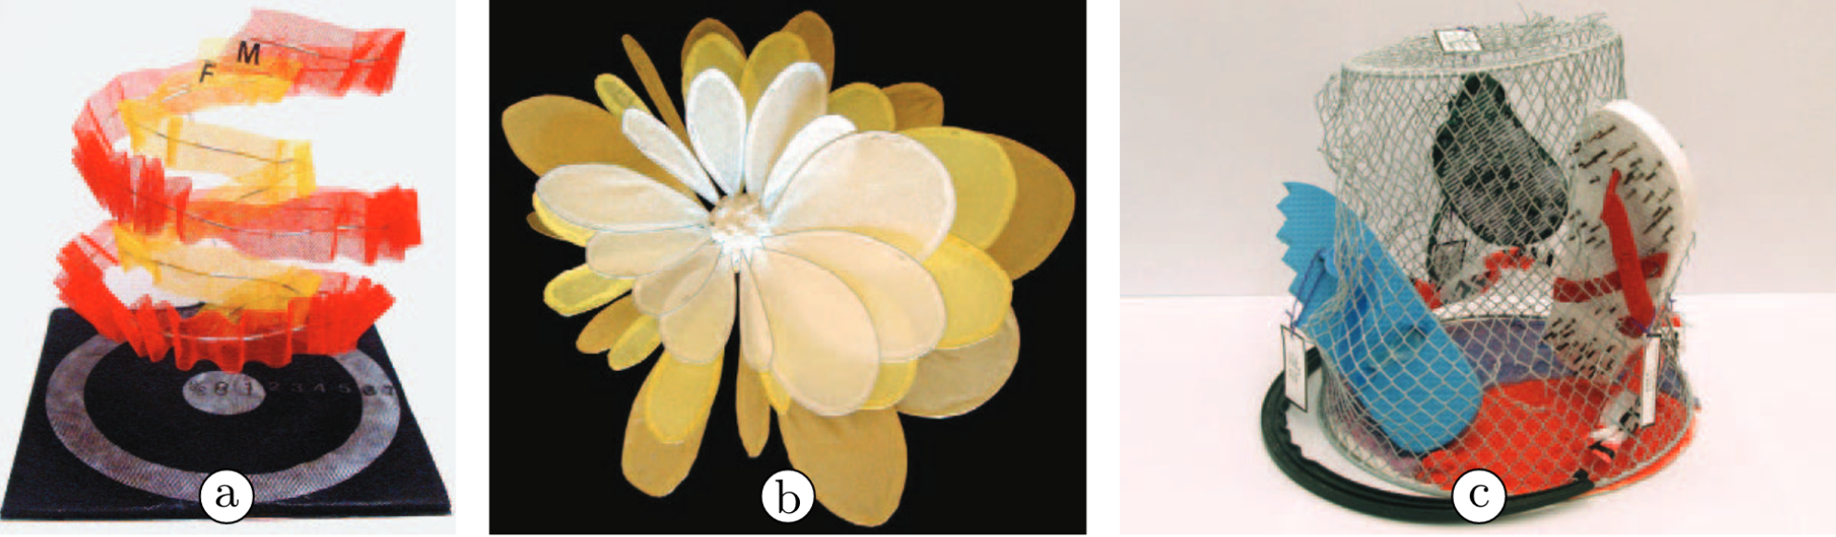
DP Vocabulary: Levels of Abstraction
Symbolic: Uses the language of graphs
Example: A 3-D printed helix representing unemployment among men and women
Here, a standard graph format is converted into three-dimensional space
Image source: https://doi.org/10.1007/978-3-319-27648-9_94-1

Slide 23
DP Vocabulary: Levels of Abstraction
Iconic: Uses the language of familiar objects/symbols
Example: A graph of Australia’s economic growth made to resemble a flower
Here, the blossoming of a flower represents the “blossoming” economy
Image source: https://doi.org/10.1007/978-3-319-27648-9_94-1

Slide 24
DP Vocabulary: Levels of Abstraction
Indexical: Uses a medium related to the data
Example: Flip-flops with nails stuck through them – every nail represents 1,000 injuries caused by wearing flip-flops
Here, a real-life object is used to represent data related to the object
Image source: https://doi.org/10.1007/978-3-319-27648-9_94-1

Slide 25
DP Examples
Let’s take a look at some examples of data physicalizations
I chose to highlight these because of their:
Poignancy
Creativity
Multi-dimensionality

Slide 26
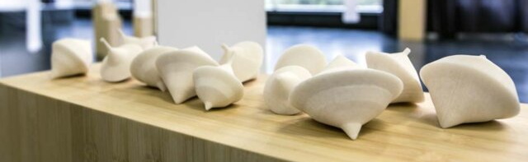
Melanie Bossert – The World’s Best Spintop (2012)
Image source: https://doi.org/10.21606/drs.2018.238
Each top represents a different nation
Shape derived from data on health, education, etc.
Tops with better outcomes stay spinning longer
Literalizes the metaphor of stability (Hogan, 2018)
Notes:
Similar to wine glasses, where nations are represented individually as objects with differing “stability”

Slide 27
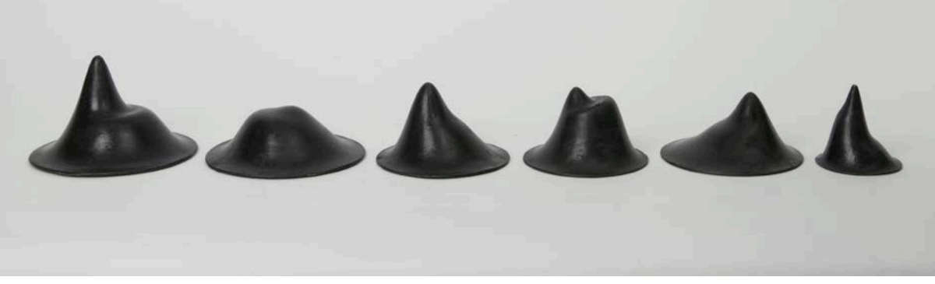
Peter Shenai & Laurence Osborn – Change Ringing (2015)
Image source: https://doi.org/10.21606/drs.2018.238
Shape of bells derived from climate data
Each bell can be rung to produce a distinct sound
Allows data to be seen, felt, and heard (Hogan, 2018)
Notes:
These last two could in theory be 3-D rendered on a computer, but this next one can’t

Slide 28
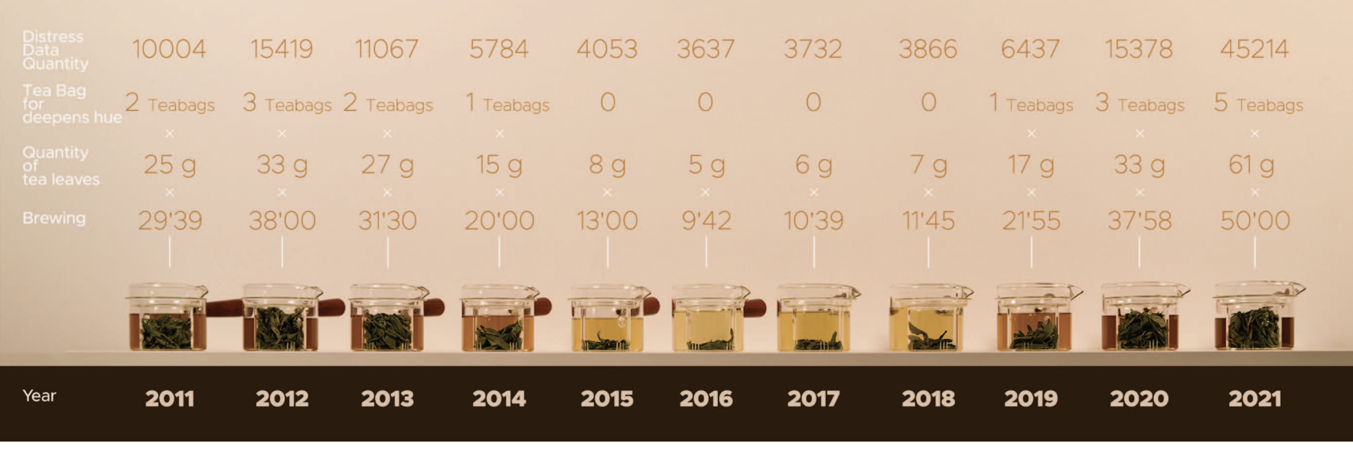
Image source: https://doi.org/10.1109/VISAP60414.2023.00010
Yufan Li, Kang Zhang, Yue Huang & Varvara Guljajeva – Bitter Data (2023)
Rare example of data edibilization
11 cups of bitter tea to represent 11 years
Amount of tea leaves determined by ”bitterness” of Chinese social media users that year (Y. Li et al., 2023)
Notes:
Also a visual component obviously
Probably not the most sanitary…

Slide 29
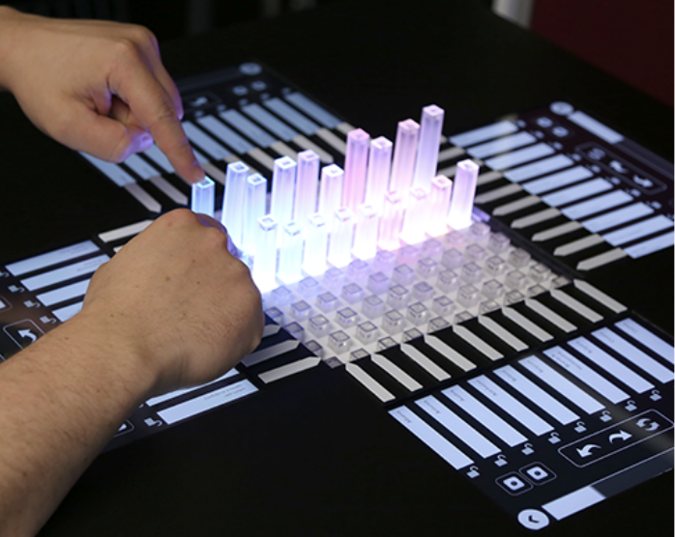
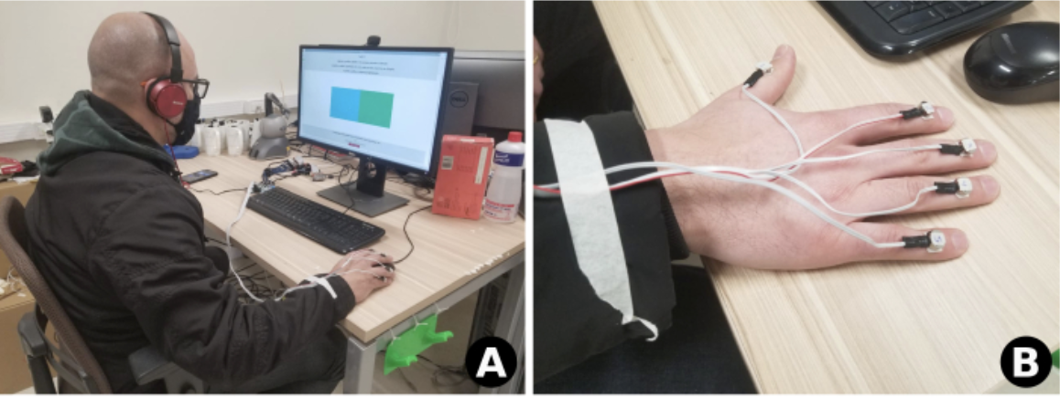
Recent Advances in DP: Sustainability
Sustainable biomaterials (Bell et al., 2024)
Why bother printing at all?
Shape-changing interfaces e.g. EMERGE (Sturdee et al., 2023)
Vibrotactile interfaces (Bastidas Cuya et al., 2021)
Image source: https://doi.org/10.1145/3544548.3581214
Image source: https://doi.org/10.1145/3488162.3488171
Notes:
Shape changing interface: a series of bars that physically move up and down to represent different bar graphs
Vibrotactile interface: gives vibrational feedback when you move your mouse over a computer screen
In both cases are very useful for visually impaired users

Slide 30
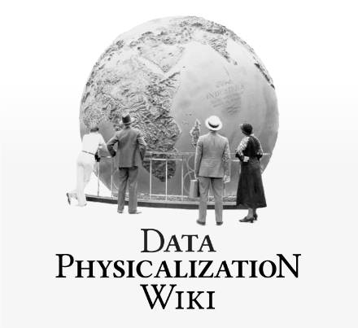
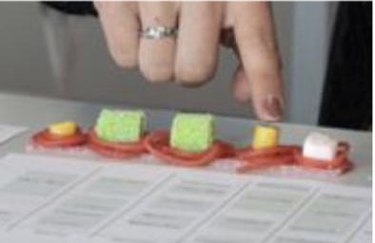
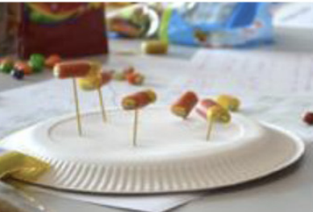
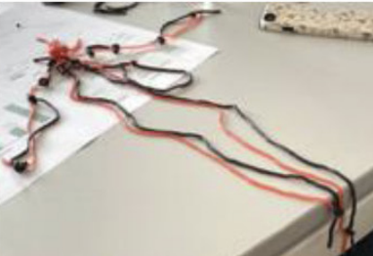
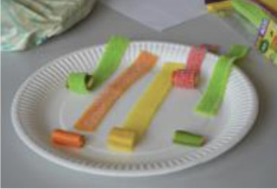
Recent Advances in DP: Education
Data Physicalization Wiki founded 2015
Workshops for children, including one using candy (Lallemand & Oomen, 2022)
University course in Germany (Baur et al., 2023)
Image source: http://dataphys.org/wiki/
Image source: https://doi.org/10.1145/3491101.3519648
Notes:
Was not able to find anything about the course in Germany sadly

Slide 31
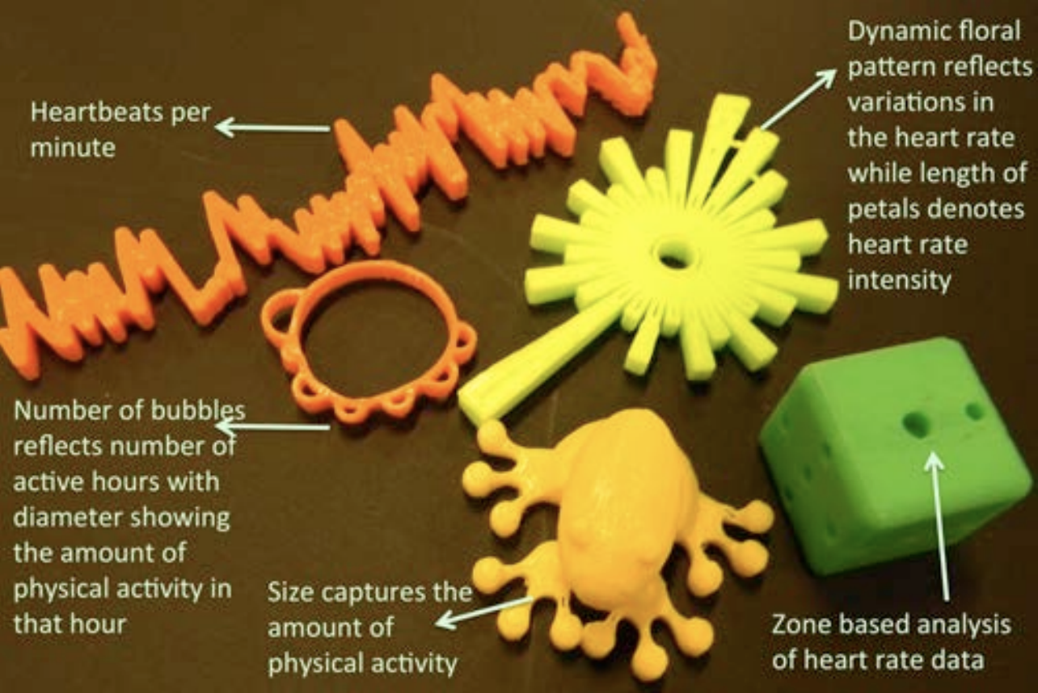
Recent Advances in DP: Personalized DPs
DPs that reflect personal activity data are helpful exercise motivators
Can be used as fashion accessories or home decor
So far this has not been extended to pets…
Data dog collars?
Image source: https://doi.org/10.1145/2556288.2557144

Slide 32
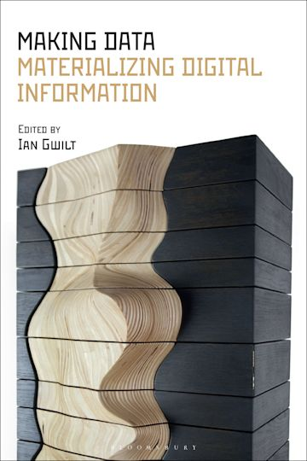
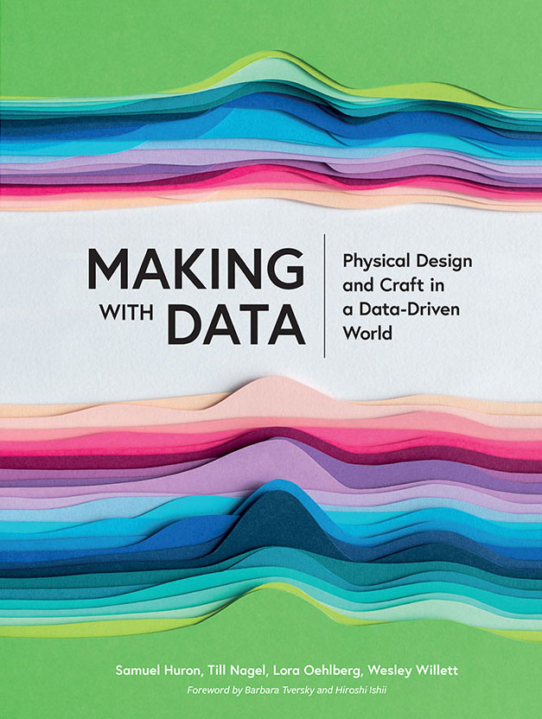
Recent Advances in DP: Books
Making data: Materializing digital information (Gwilt, ed., 2022)
Making with data: Physical design and craft in a data-driven world (Huron et al., eds., 2023)
Image sources: https://www.bloomsbury.com/ca/making-data-9781350133235/, https://makingwithdata.org/
Notes:
If we were in person and I had access to the books, I would have passed them around at the beginning of my talk

Slide 33
Works Cited
Primary Sources
Data Physicalization Wiki (2024). Retrieved from http://dataphys.org/
Dragicevic, P., Jansen, Y., & Vande Moere, A. (2021). Data physicalization. In J. Vanderdonckt, P. Palanque, & M. Winckler (Eds.), Springer Handbook of Human Computer Interaction. Springer, Cham. https://doi.org/10.1007/978-3-319-27648-9_94-1
Jansen, Y., Dragicevic, P., Isenberg, P., Alexander, J., Karnik, A., Kildal, J., Subramanian, S., & Hornbæk, K. (2015, April). Opportunities and challenges for data physicalization. Proceedings of the 33rd Annual ACM Conference on Human Factors in Computing Systems, 3227–3236. https://doi.org/10.1145/2702123.2702180
Additional Sources
Baur, C., Wienrich, C., & Hurtienne, J. (2023, April). Location, aim, and audience of data physicalisations: Design approaches instead of frameworks. Physicalization from Theory to Practice: Exploring Physicalization Design across Domains. ACM CHI Conference on Human Factors in Computing Systems, Hamburg, Germany. http://dataphys.org/workshops/chi23/wp-content/uploads/sites/8/2023/03/230215_PositionpaperDataPhysWS-Cordula-Baur.pdf
Bell, F., Wu, S., Campo Woytuk, N., Lazaro Vasquez, E. S., Alistar, M., & Buechley, L. (2024). Making biomaterials for sustainable tangible interfaces. Proceedings of the Eighteenth International Conference on Tangible, Embedded, and Embodied Interaction, 1–5. https://doi.org/10.1145/3623509.3634740
Gwilt, I. (Ed.). (2022). Making data: Materializing digital information. Bloomsbury Visual Arts.
Hogan, T. (2018, June). Data sensification: Beyond representation modality, toward encoding data in experience. Design as a Catalyst for Change - DRS Conference 2018. https://doi.org/10.21606/drs.2018.238
Hornecker, E., Hogan, T., Hinrichs, U., & Van Koningsbruggen, R. (2023). A design vocabulary for data physicalization. ACM Transactions on Computer-Human Interaction, 31(1), 2:1-2:62. https://doi.org/10.1145/3617366
Huron, S., Nagel, T., Oehlberg, L., & Willett, W. (Eds.). (2023). Making with data: Physical design and craft in a data-driven world (First edition). AK Peters: CRC Press.
Lallemand, C., & Oomen, M. (2022). The candy workshop: Supporting rich sensory modalities in constructive data physicalization. Extended Abstracts of the 2022 CHI Conference on Human Factors in Computing Systems, 1–7. https://doi.org/10.1145/3491101.3519648
Li, X. (2020). Wealth Inequality. Infopoetry. https://infopoetry.densitydesign.org/infopoetries/wealth-inequality
Li, Y., Zhang, K., Huang, Y., & Guljajeva, V. (2023). Bitter data: An exploration into data edibilization of negative emotion. 2023 IEEE VIS Arts Program (VISAP), 44–59. https://doi.org/10.1109/VISAP60414.2023.00010
Starrett, C., Reiser, S., & Pacio, T. (2018). Data materialization: A hybrid process of crafting a teapot. SIGGRAPH ‘18: ACM SIGGRAPH 2018 Art Gallery, 381–385. https://doi.org/10.1145/3202918.3203087

